Slide 1
Comparative Deep Neural Study For Stage-Wise Alzheimer’s Disease Detection Using Brain MRI
Shashank Shetgeri Affiliation
Srushti Honnangi Affiliation
Anushri Kajagar Affiliation
Tanvi Korgaonkar Affiliation

Slide 2
Contents
Abstract
Introduction
Literature Survey
Problem Definition
Proposed Work
Methodology &Implementation
Results & Discussions
Conclusion
References

Slide 3
Abstract
Alzheimer’s disease (AD) is a progressive neurological disorder where accurate stage recognition is essential for treatment planning. This study classifies four stages (Non, Very Mild, Mild, Moderate dementia) using balanced ADNI MRI data. A unified deep-learning pipeline with one custom CNN and five transfer-learning models (VGG16, ResNet50, DenseNet201, InceptionV3, EfficientNet-B1) was developed with consistent preprocessing and training. The custom CNN, VGG16, and DenseNet201 achieved 95–98% accuracy and macro-F1, outperforming EfficientNet-B1 and InceptionV3. Results indicate well-tuned 2D CNNs are highly effective for stage-wise AD classification and suitable for clinical CAD applications.

Slide 4
Introduction
Alzheimer’s disease (AD) progressively damages brain cells, affecting memory, language, reasoning, and behavior, especially in older adults, and reducing quality of life. With increasing life expectancy, AD cases are rising, creating healthcare challenges and making early, accurate stage detection essential for treatment planning. Structural MRI is widely used to examine brain anatomy and detect atrophy non-invasively, while PET and other scans also support AD assessment. Deep learning has enhanced image interpretation, enabling faster and more reliable diagnosis. A dependable stage-wise classifier can assist radiologists by automatically identifying early dementia cases for timely review. This work aims to develop a unified deep-learning pipeline for four-stage AD classification and compare multiple models.

Slide 5
Literature Survey
Author & Year | Data / Features Used | Model Used | Accuracy / Findings | Limitation / Research gap
Chen et al. (2024) | Structural MRI | Improved ResNet50‑based deep model | ≈98% AD accuracy.​ | Single‑dataset, no broad external test.​
Turrisi et al. (2024) | MRI (ADNI) | CNNs with varied setups | Shows modeling choices change accuracy by 82%. | Study is analysis‑focused, not an optimized solution.​
El‑Assy et al. (2024) | Early‑stage AD MRI | Novel CNN | Mid/high‑90% early‑AD accuracy.​ | Limited multicenter validation.​
Shaji & Helaly (2025) | MRI (AD, MCI, HC) | CNN multi‑class framework | >95% stage accuracy.​ | Few comparisons with newer models.​
Alharbi (2024) | MRI‑based brain graphs | Spectral GCN | ≈95% accuracy, better than CNNs.​ | Graph design and interpretability still weak.​

Slide 6
Literature Survey
Author & Year | Data / Features Used | Model Used | Accuracy / Findings | Limitation / Research gap
Vinukonda et al. (2025) | MRI (4 classes: ND, VMD, MD, MOD) | IDeepLabV3+ + LeNet‑5 + Enhanced ResNeXt | ≈98% multi‑class accuracy for early and multi‑stage AD.​ | Single dataset; clinical generalization unclear.​
Arya et al. (2023) | MRI, PET, clinical (review) | ML & DL (SVM, CNN, hybrid) | Many studies 80–90%; some multimodal low‑/mid‑90%.​ | Datasets small, imbalanced; few external validations.​
Sorour et al. (2024) | Structural MRI | Deep CNN | High AD/MCI/control accuracy (≈95%+).​ | Limited sites; effect of scanner variation not studied.​
Fundación Dialnet (2024) | MRI, PET, biomarkers (review) | ML/DL, hybrid, graph models | Imaging + biomarkers improves stage‑wise AD classification.​ | Need standard multimodal benchmarks and interpretable models.​
Bit et al. (2024) | MRI for mild cognitive disease | U‑Net + EfficientNet + SVM | ≈97–98% accuracy with explanations.​ | No longitudinal or multi‑center testing.​

Slide 7
Literature Survey
Author & Year | Data / Features Used | Model Used | Accuracy / Findings | Limitation / Research gap
Rao & Aparna (2023) | MRI | Deep CNN / transfer learning | Accuracy just above 90% for AD severity analysis.​ | Below top accuracy; no multimodal comparison.​
Odusami et al. (2024) | MRI + PET | Multimodal deep learning | Multimodal PET+MRI outperforms single‑modality models.​ | PET costly and less available for routine use.​
Raza et al. (2024) | Multi‑view MRI | Ensemble CNN | ≈97–98% accuracy using multi‑view MRI slices.​ | High computation; deployment not discussed.​
Vashishtha (2023) | MRI with class imbalance | Hybrid DL + SMOTE | ≈99% accuracy for early AD detection.​ | SMOTE may overfit; needs external validation.​
Baili & Alqahtani (2025) | MRI + other neuroimaging | Deep multi‑class classifier | Improved AD vs other neurodegenerative diseases (often ≥95%).​ | Limited diseases and prospective clinical testing.

Slide 8
Problem Definition
Alzheimer’s disease requires accurate stage-wise identification to support timely treatment and clinical decision-making. However, many existing studies either focus on limited classes or lack consistent evaluation across multiple deep-learning architectures. There is a need for a unified and reliable system that can classify
four AD stages (Non, Very Mild, Mild, Moderate dementia) using structural MRI with high accuracy and clinical reliability. This work addresses the problem by developing and comparing multiple CNN-based deep-learning models within a standardized pipeline to determine the most effective approach for stage-wise AD detection.

Slide 9
Proposed Work
This work aims to develop a unified deep-learning pipeline for classifying Alzheimer’s disease into four stages—Non, Very Mild, Mild, and Moderate dementia—using structural brain MRI. The study evaluates a custom CNN alongside five transfer-learning architectures (VGG16, ResNet50, DenseNet201, InceptionV3, and EfficientNet-B1) under the same preprocessing, augmentation, and stratified training setup to determine which model families deliver the most reliable stage-wise diagnosis and clinical applicability.

Slide 10
Methodology & Implementation
The MRI dataset is balanced across four diagnostic classes and split using patient-wise stratified partitioning for training, validation, and testing. Key preprocessing includes slice extraction, resizing, normalization, and MRI-appropriate augmentation to enhance model robustness. All six models are trained using the Adam optimizer and Cross-Entropy loss with early stopping and checkpointing to control overfitting. Performance is evaluated using accuracy, precision, recall, macro-F1, and weighted metrics to ensure fair assessment across classes.

Slide 11
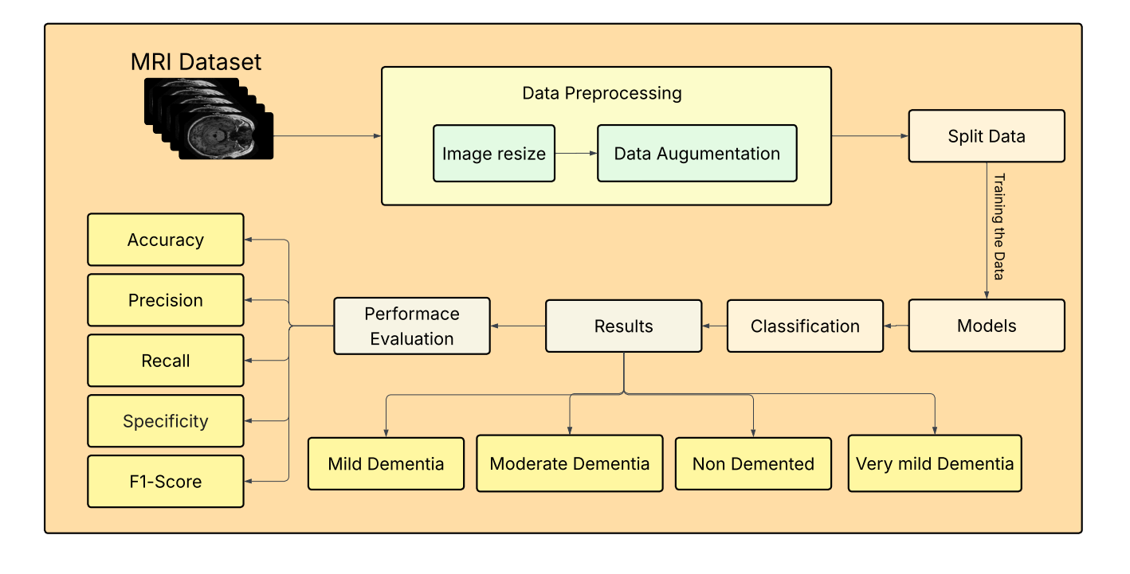
Methodology & Implementation

Slide 12
Results & Discussions
The experimental results show that the custom CNN, VGG16, and DenseNet201 achieve the highest accuracy and macro-F1 scores (around 95–98%), demonstrating strong capability in distinguishing all four AD stages. ResNet50 performs moderately well, whereas EfficientNet-B1 and InceptionV3 exhibit comparatively lower and unstable performance under the present setup. These outcomes indicate that carefully optimized 2D CNN architectures are highly effective for multi-stage AD classification and provide a consistent, reliable comparison across different deep-learning families

Slide 13
Conclusion
The proposed unified pipeline successfully demonstrates accurate four-stage Alzheimer’s disease detection using structural MRI, with custom CNN, VGG16, and DenseNet201 emerging as the most efficient and dependable models. The study confirms that deeper or more complex architectures do not necessarily guarantee better performance in this context, while well-designed 2D CNNs can effectively support stage-wise diagnosis. Future extensions include exploring 3D MRI, multimodal imaging, and external validation to enhance real-world clinical reliability.

Slide 14
References
Chen, Y.Automated Alzheimer’s disease classification using deep learning. ScienceDirect(2024).Available at:https://www.sciencedirect.com/science/article/pii/S1687850723002601
Vinukonda, E.R.: An integrated deep learning model for early and multi-class Alzheimer’s disease diagnosis. Nature (2025). Available at: https://www.nature.com/articles/s41598-025-01845-ynature​
Arya, A.D.A systematic review on machine learning and deep learning approaches for Alzheimer’s disease diagnosis using MRI and PET. Springer (2023).Availableat:https://link.springer.com/article/10.1186/s40708-023-00195-7​
Shaji, A., Helaly, H: Novel deep learning for multi-class classification of Alzheimer’s dementia stages. Frontiers in Bioinformatics (2025). Available at:https://www.frontiersin.org/journals/bioinformatics/articles/10.3389/fbinf.2025.1567219
Sorour, S.E.,: Classification of Alzheimer’s disease using MRI data based on deep learning. ScienceDirect (2024). Available at: https://www.sciencedirect.com/science/article/pii/S1319157824000296
Fundación Dialneti : Advancements in Alzheimer’s disease classification: Integrating machine learning, neuroimaging, and biomarkers. Dialnet (2024). Available at: https://dialnet.unirioja.es/servlet/articulo?codigo=9968874
Turrisi, R., Verri, A., and Barla, A.: Deep learning-based Alzheimer’s disease detection: reproducibility and the effect of modeling choices. Frontiers in Computational Neuroscience (2024). Available at: https://www.frontiersin.org/journals/computational-neuroscience/articles/10.3389/fncom.2024.1360095/full

Slide 15
References
Subhrangshu Bit, Pritam Dey, Arnab Maji: MRI-based mild cognitive disease classification (2024). Available at: https://journals.sagepub.com/doi/abs/10.1177/25424823241290694
El-Assy, A.M..: A novel CNN architecture for accurate early detection and classification of Alzheimer’s disease. Nature (2024). Available at: https://www.nature.com/articles/s41598-024-53733-6
Rao, B.S., Aparna, M.: Alzheimer’s disease through analysis of MRI images using deep learning techniques. IEEE (2023). Available at: https://ieeexplore.ieee.org/abstract/document/10182253​
Odusami, M. Alzheimer’s disease recognition from MRI and PET imaging data. Heliyon (2024). Available at: https://www.cell.com/heliyon/fulltext/S2405-8440(24)10433-1
Raza, H.A. Alzheimer’s classification: machine learning and deep learning hybrid approach using multi-view MRI. Scientific Reports (2024). Available at:https://www.nature.com/articles/s41598-024-81563-z
Anuradha Vashishtha., Hybrid model: deep learning method for early detection of Alzheimer’s disease from MRI images. Biomedical and Pharmacology Journal (2023). Available at: https://pdfs.semanticscholar.org/7d26/3c8383eb284f54971d70064ad0ccc3cf908b.pdf
Hadeel Alharbi:Spectral graph convolutional neural network for Alzheimer’s disease classification. Frontiers in Neuroinformatics (2024). Available at: https://www.frontiersin.org/journals/neuroinformatics/articles/10.3389/fninf.2024.1495571
Baili, J., Alqahtani:Enhancing multi-class neurodegenerative disease classification with deep learning. Frontiers in Medicine(2025).Available: https://www.frontiersin.org/journals/medicine/articles/10.3389/fmed.2025.1562629/full

Slide 16
THANK YOU

